Slide 1
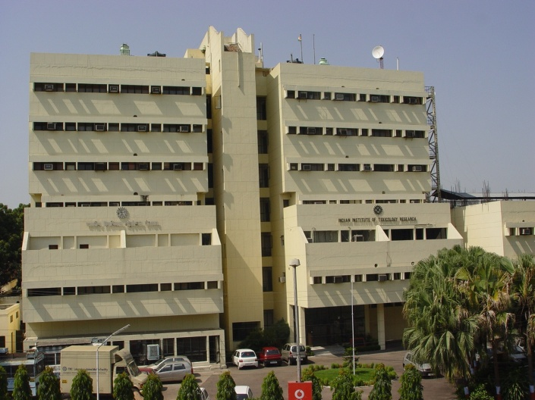

Safety/ Toxicity testing and
Knowledge dissemination
Dr. Debapratim Kar Chowdhuri
Chief Scientist & Professor, AcSIR
CSIR-Indian Institute of Toxicology Research, Lucknow
Uttar Pradesh, India
E.mail: dkchowdhuri@iitr.res.in

Slide 2
ENMs
Synthesis
Charac-terization
Cyto-toxicity
Geno-toxicity
Immuno-toxicity
Neuro-toxicity
Dermal toxicity
Nephro-toxicity
Repro-ductive Toxicity
ADME
Environ-mental Toxicity
Eco-toxicity
In Silico prediction
Enabling IITR expertise for NMT

Slide 3
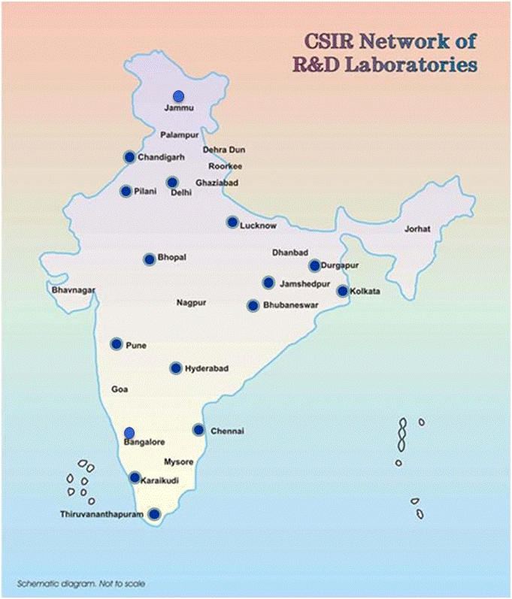

Nanomaterials: Applications and Impact on
Safety, Health and Environment
(NanoSHE) (2012-17)
NWP-35 (2007-12)
Fourteen laboratories across the country
CSIR-CCMB, CSIR- CDRI, CSIR- CFTRI, CSIR- CLRI, CSIR- CSIO, CSIR- IGIB, CSIR- IHBT, CSIR- IICT, CSIR- IMTECH, CSIR- NCL, CSIR- NEIST, CSIR- NIIST, CSIR- NPL, CSIR-IITR

Slide 4
Models and methods for the toxicity/safety of ENMs and products
In vitro: 14
In vivo: 04
Ecotoxicity: 04
Established and validated/ at different stages of validation at IITR

Slide 5
Models and methods for the toxicity/safety of ENMs and products
In vitro models
Neurotoxicity
Genotoxicity
Immunotoxicity
Nephrotoxicity
Hepatotoxicity
Neuro-immunotoxicity
Phototoxicity

Slide 6
Models and methods for the toxicity/safety of ENMs and products
In vivo models
Immunotoxicity
Nephrotoxicity
Genotoxicity
GI-Toxicity

Slide 7
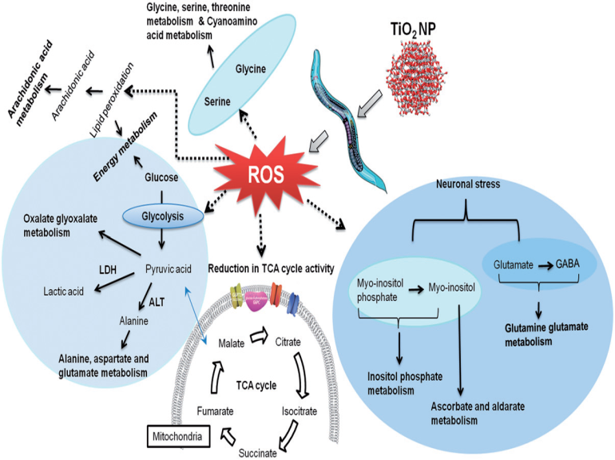
Models and methods for the toxicity/safety of ENMs and products
CED-1::GFP
Control
Ecotoxicity models
Paramecium caudata
Tetrahymena pyriformis
Caenorhabditis elegans
Eisenia fetida
ZnCl₂
Bulk ZnO
GFP expression in cells-corpse in the germ-line of worms
21nm ZnO
35nm ZnO
65nm ZnO

Slide 8
Ecotoxicity of nanomaterials
Approach
Bacteria
Uptake,
Toxicity
Paramecium
Biochemical Studies
Eco- Toxicity
Tetrahymena
Fecundity / growth
Daphnia
Earthworm
Omic-approaches and validation
Zebra Fish
Mechanism of toxicity
C. elegans

Slide 9
Nanomaterials evaluated for in vitro/in vivo toxicity/safety at CSIR-IITR
Category | Nanomaterials
Metal NPs | Au, Ag, Pt
Metal oxide NPs | ZnO, TiO₂, CeO₂, Cr₂O₃, CuO, Fe₂O₃
Quantum dots | Mn-ZnS, CdTe
Carbon based NMs | Fullerenes, Carbon nanotubes, Graphene oxide
Polymers | PLGA, PEI, O-hexadecyl-dextran
Nano encapsulated compounds | Bromelain loaded PLGA nanoparticles Gellan gum blended PEI nanocomposite O-hexadecyl-dextran entrapped berberine nanoparticles Nitotine encapsulated PLGA nanoparticles Polyglutamic acid-based nanocomposites Linear PEI nanoparticles

Slide 10
IMPACT
Nanomaterials | Publications | Citations
ZnO | 12 | 849
TiO₂ | 8 | 552
Fullerenes | 1 | 220
CuO | 1 | 124
Fe₂O₃ | 1 | 114
Graphene oxide | 1 | 46
Cr₂O₃ | 3 | 20
CeO₂ | 1 | 14
CNTs | 2 | 8
Polymers, Polymer encapsulated phyto chemicals, etc. | 9 | 110
Publications selected as cover page articles in reputed journals
Toxicology Letters 185; 211-218, 2009. (This article featured in the European Commission document “Science for Environment Policy- Nanomaterials, Issue 12, page 4, April 2009”)
Established/ validated models available for toxicity/safety assessment of ENMs

Slide 11
IMPACT
CSIR-IITR as a Member, ISO/TC229 (nanotechnologies) was instrumental in getting Eleven ISO standards approved and adopted by BIS (MTD-33; CSIR-IITR as coordinator), Government of India.
Two standards for methods in nanomaterial toxicology (Eco-toxicity methods) formulated, have been submitted to BIS for ISO approval.

Slide 12
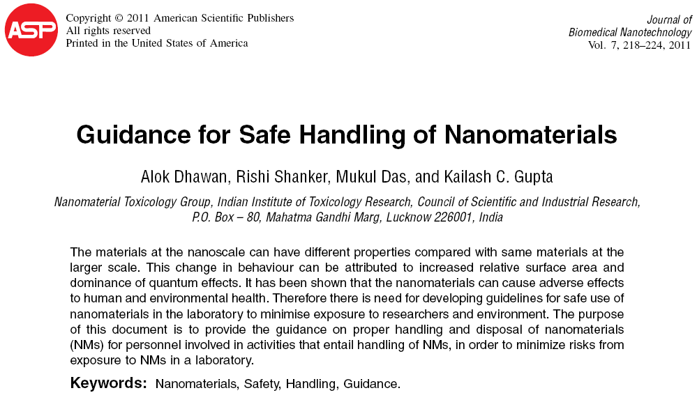
Guidelines for safe handling of nano-materials in laboratory
Updating of guidelines in progress (ICMR and DST, Govt. of India)

Slide 13








Dissemination
Conferences
International Conference on Nanomaterial Toxicology’ held at CSIR-IITR, Lucknow, India, February 5-7, 2008.
International Symposium on The Safe Use of Nanomaterials & Workshop on Nanomaterial Safety: Status, Procedures, Policy and Ethical Concerns’ held at CSIR-IITR, Lucknow, India, February 1-3, 2011.
Workshops
Methods in Nanomaterial Toxicology held at CSIR-IITR, Lucknow, India, February 4-6, 2011.
Applications of Flow cytometry in Nanomaterial Toxicology, held at CSIR-IITR, Lucknow, India, January 18-22, 2010.
Lectures to school children on safety issues pertaining to nano-materials and nanotechnologies (Under DST-INSPIRE Scheme by CSIR-IITR faculty)
~400 students who are among board toppers studying science (Class XI & XII) in different schools across two states (Uttar Pradesh and West Bengal, India) (2012-14).
DBT

Slide 14
Dissemination-contd….
Special issues of journals (Guest edited by CSIR-IITR faculty)
Nanotoxicology Jan 2008, Vol. 2, No. s1: S2–S88. Abstracts of ICONTOX 2008, Lucknow, India, February 5-7, 2008.
Nanotoxicology, Volume 3, Number 1 (2009). Selected papers presented at the International Conference on Nanomaterial Toxicology held at Indian Institute of Toxicology Research, Lucknow, India from February 5-7, 2008.
Journal of Biomedical Nanotechnology, volume 7, Number 1(2011)

Slide 15
Thank you

