Slide 1


Silver Nanoparticle and Ecotoxicology Research
Some Uncertainties
Mila Tejamaya, PhD
Lecturer at Occupational Health and Safety Department
Faculty of Public Health
University of Indonesia

Slide 2
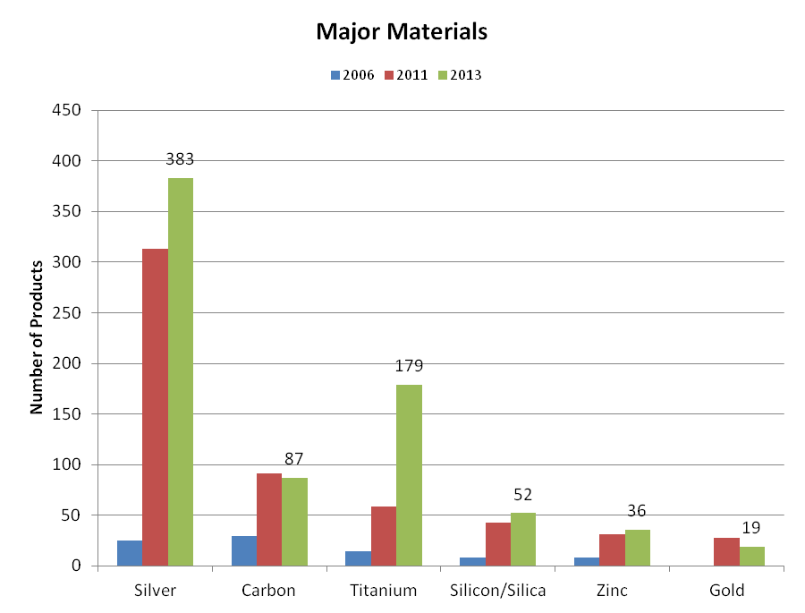
Why AgNPs are interesting?
AgNPs are the most rapidly growing classes of nanoproducts
AgNPs has been commercialized, so that the exposure to human and environment is expected
silver in nanosize shows unique optical, electrical, magnetic and therapetic properties
most of AgNPs applications in range of product are applied to bestow antimicrobial properties
http://www.nanotechproject.org/cpi/site/assets/files/3551/chart_5.png
Notes:
The most common material mentioned in the product descriptions is now silver (383 products). Titanium (179), which includes titanium dioxide, has surpassed Carbon (87), which includes fullerenes, followed by silica (52), zinc (including zinc oxide) (36), and gold (19).

Slide 3
RISK =
HAZARD
EXPOSURE
X
HAZARD DRIVEN APPROACH:
Indication of AgNPs (eco)toxicity :
Algae
Bacteria
Daphnia magna
Zebrafish
Fish
Human
(Fabrega 2011)
EXPOSURE DRIVEN APPROACH:
AgNPs release from:
Textile
Paints
Washing machine
Waste water treatment
etc

Slide 4
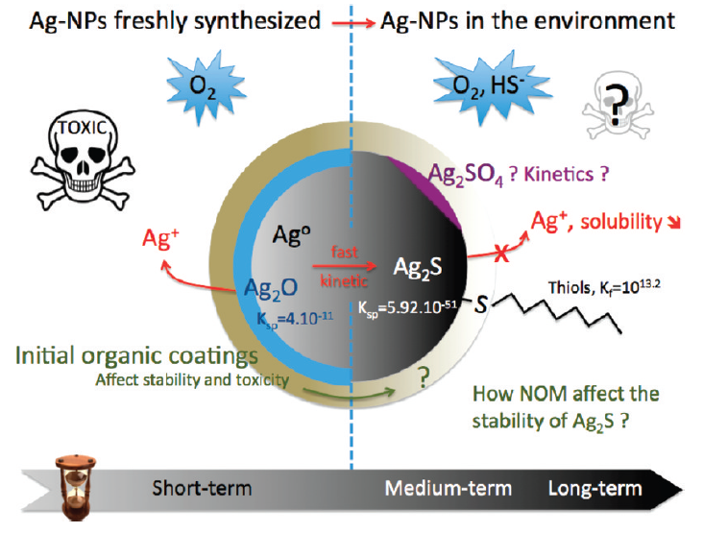
Complex behavior of AgNPs as source of uncertainties
Homo-aggregation
Hetero-aggregation
Dissolution
Shape transformation
Other transformation
NPs Stability Test
(Levard, Hotze et al. 2012)

Slide 5
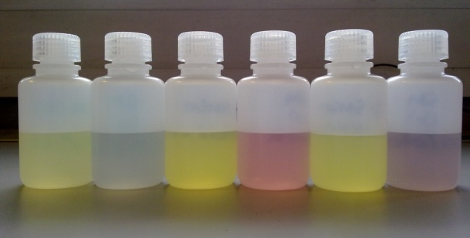
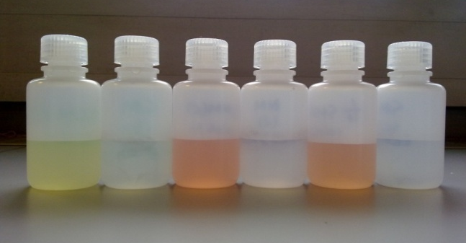
Stability Study: Citrate capped AgNPs
Colour changes of citrate-coated AgNPs in different media
immediately after media addition (left); after 24 hours (right)

Slide 6
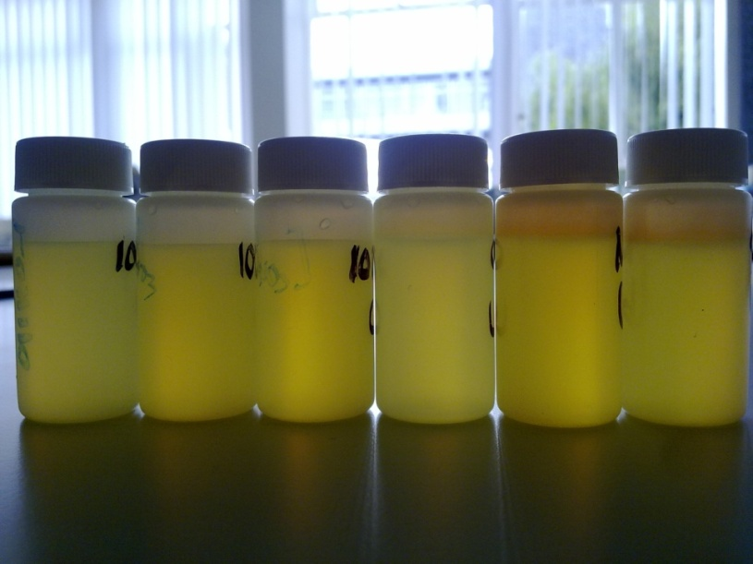
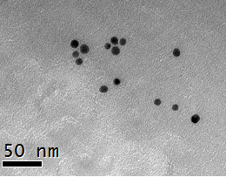
Stability Study: PVP capped AgNPs

Slide 7
References:
Fabrega, J., R. Zhang, et al. (2011). "Impact of silver nanoparticles on natural marine biofilm bacteria." Chemosphere 85(6): 961-966.
Hassellöv, M., J. Readman, et al. (2008). "Nanoparticle analysis and characterization methodologies in environmental risk assessment of engineered nanoparticles." Ecotoxicology 17(5): 344-361.
Handy, R., F. Kammer, et al. (2008). "The ecotoxicology and chemistry of manufactured nanoparticles." Ecotoxicology 17(4): 287-314.
Handy, R., R. Owen, et al. (2008). "The ecotoxicology of nanoparticles and nanomaterials: current status, knowledge gaps, challenges, and future needs." Ecotoxicology 17(5): 315-325.
Hansen, S. F., B. H. Larsen, et al. (2007). "Categorization framework to aid hazard identification of nanomaterials." Nanotoxicology 1(3): 243-U369.
Hassellöv, M. and R. Kaegi (2009). Analysis and characterization of manufactured nanoparticles in aquatic environments. Environmental and Human Health Impacts of Nanotechnology. J. R. Lead and E. Smith, John Wiley & Sons, Inc.: United Kingdom.
Kaegi, R., B. Sinnet, et al. (2010). "Release of silver nanoparticles from outdoor facades." Env. Pollut. 158(9): 2900-2905
Klaine, S. J., P. J. J. Alvarez, et al. (2008). "Nanomaterials in the environment: behavior, fate, bioavailability and effects." Environmental Toxicology and Chemistry 27(9): 27.
Levard, C. m., E. M. Hotze, et al. (2012). "Environmental transformations of silver nanoparticles: impact on stability and toxicity." Environmental Science & Technology 46(13): 6900-6914.
Nowack, B. and T. D. Bucheli (2007). "Occurrence, behavior and effects of nanoparticles in the environment." Env. Pollution 150(1): 5-22.

Slide 8
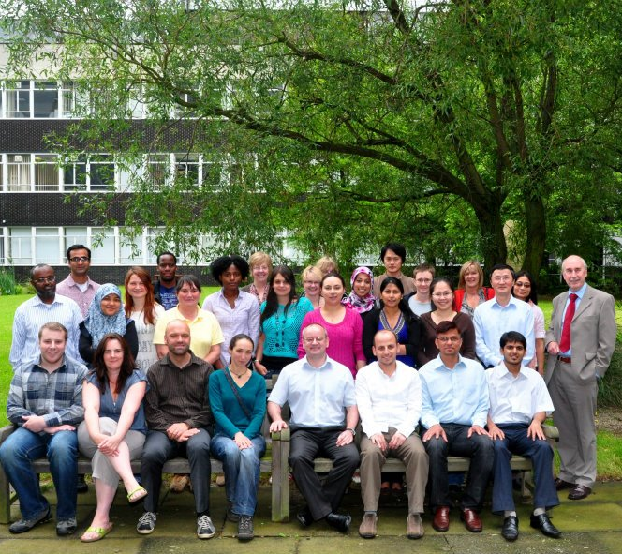
Thank you for your kind attention
Mila Tejamaya
tejamaya@ui.ac.id
mila.tejamaya@gmail.com
Department of Occupational Health and Safety
C Building 1st floor
Faculty of Public Health
University of Indonesia
Depok, West Java
16424
Phone: +62-21-78849033
Mobile: +62-811-18-10100
Fax: +62-21-7863487

