Slide 1
NANOTECHNOLOGY & OHS IN INDONESIA
Presented by : Lelitasari – 4Life OHS Services
Nanosafety Asia-Pasific Regional Workshop, Bangkok, September 10th-11th 2015

Slide 2

ABOUT
Occupational
Health and Safety Services
Our website www.4LifeIndonesia.com

Slide 3

OUR VISION :
Make People at Workplace
Safe and Healthy

Slide 4

OUR SERVICES
SAFETY AND HEALTH
RISK ASSESSMENT
WORK ENVIRONMENT
MEASURING
SAFETY AND HEALTH
TRAINING AND CONSULTING

Slide 5
HUMAN RESOURCES IN NANOTECHNOLOGY IN INDONESIA*²
2009 : 620 Researcher

Slide 6
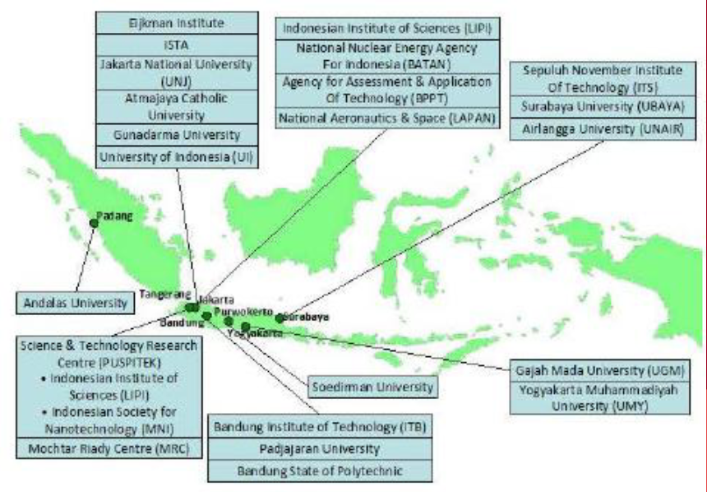
NANOTECHNOLOGY RESEARCH CENTRE IN INDONESIA*²

Slide 7
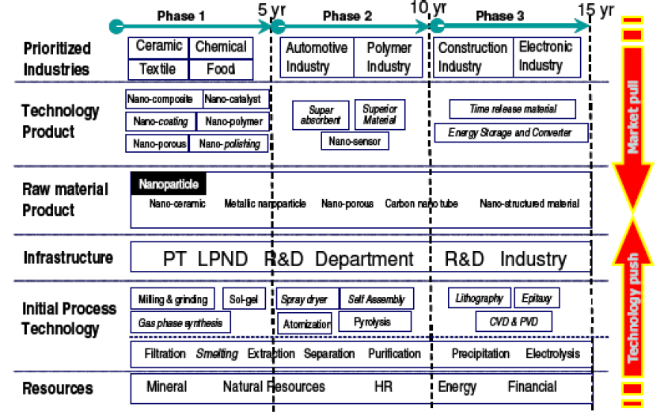
NANOTECHNOLOGY DEVELOPMENT ROADMAP TO SUPPORT NATIONAL INDUSTRY BASED ON
MARKET PULL – TECHNOLOGY PUSH APPROACHES*²
Source : Ministry of Industry,2008

Slide 8
SOURCE OF NANOTECHNOLOGY
IN INDUSTRY*¹

Slide 9
NANO SAFETY AND HEALTH REGULATION IN INDONESIA
So far, there isn’t any regulation yet on Occupational Safety and Health for Nanomaterial handling from Ministry of Manpower, Ministry of Health nor others Ministers.

Slide 10
NANOSAFETY TOPIC IN
PUBLIC HEALTH FACULTY CURRICULUM
Nanosafety topic has not been entered in the educational curriculum of undergraduate/postgraduate Occupational Safety and Health Program in universities
Dissemination about Nano Safety to Public Health Faculty in Universities in Indonesia is needed

Slide 11
Reference
Road Map Pengembangan Teknologi Industri Berbasis Nanoteknologi, Departemen Perindustrian, Badan Penelitian dan Pengembangan Industri, 2008
2. Current Status, Development of Nanotechnology in Indonesia, 2011
3. Innovation in Nanotechnology an Asia-Pasific
Perspective, Asian and Pasific Centre for
Transfer of Technology (APCTT),ESCAP,2010

