Slide 1
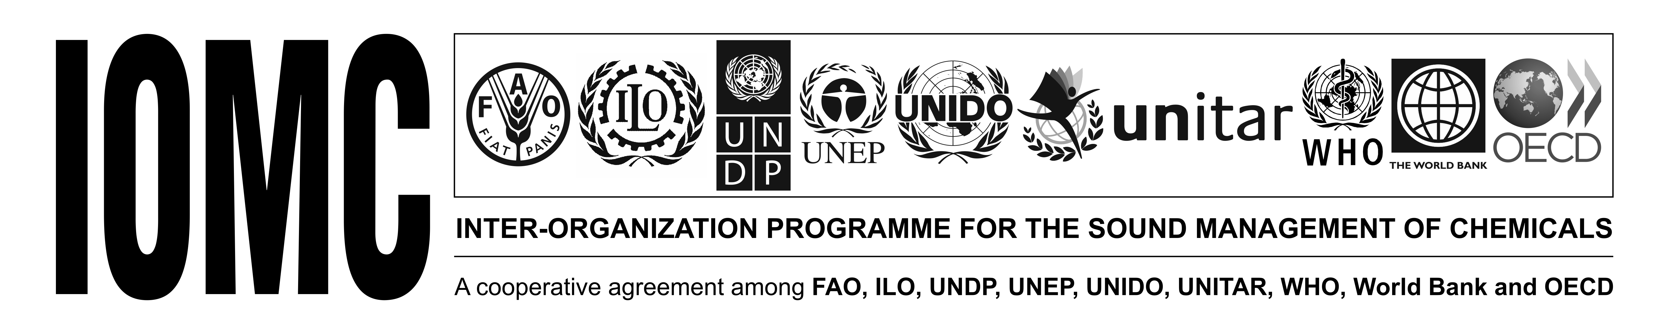


Introduction to the
IOMC Toolbox for Decision-Making in Chemicals Management
The project is
implemented
by IOMC
The project is funded by
The European Union
June 2015

Slide 2


  Inter-Organization Programme for the Sound Management of Chemicals (IOMC)
  Established in 1995
    Objective: To strengthen international cooperation in the field of chemicals and to increase the effectiveness of the organisations’ international chemicals programmes
The project is
implemented
by IOMC
The project is funded by
The European Union

Slide 3
  Examples of activities:
      SAICM:
        QSPTF Implementation Committee
        Assisting countries to implement projects
        Participating in SAICM regional meetings and co‐organizing back‐to‐back workshops
        Developing guidance for SAICM implementation/capacity building
        Contributing to the implementation of SAICM activities on emerging issues
      IOMC products
      Joint activities
  Inter‐Organization Coordinating Committee, WHO Secretariat
www.iomc.info
The project is
implemented
by IOMC
The project is funded by
The European Union

Slide 4
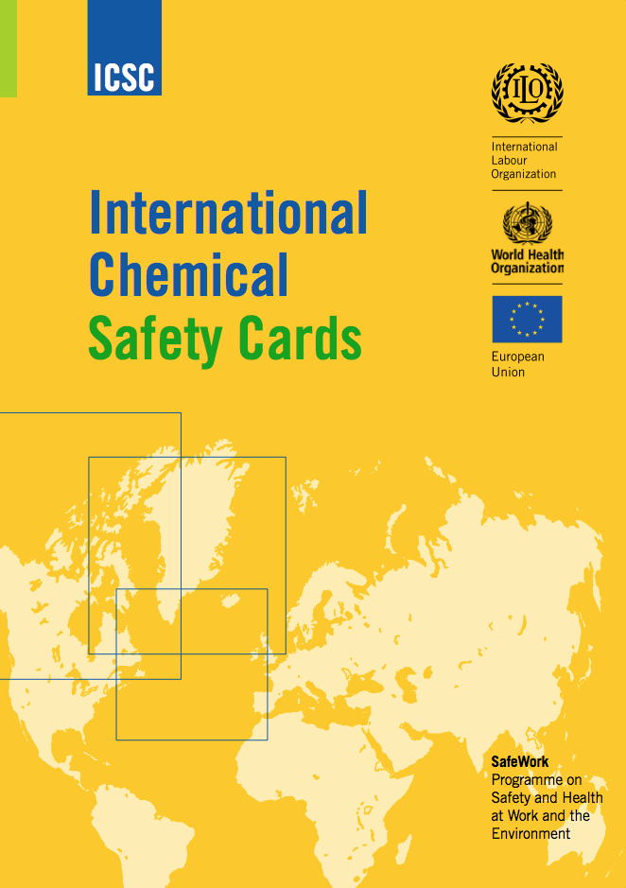


IOMC Toolbox: The Challenge
IOMC Participating Organizations have developed hundreds of tools and guidance documents that are relevant for countries in their efforts to
implement SAICM
However, finding the most
appropriate tool or guidance
document to address specific
national issues can be a challenge
The project is
implemented
by IOMC
The project is funded by
The European Union

Slide 5
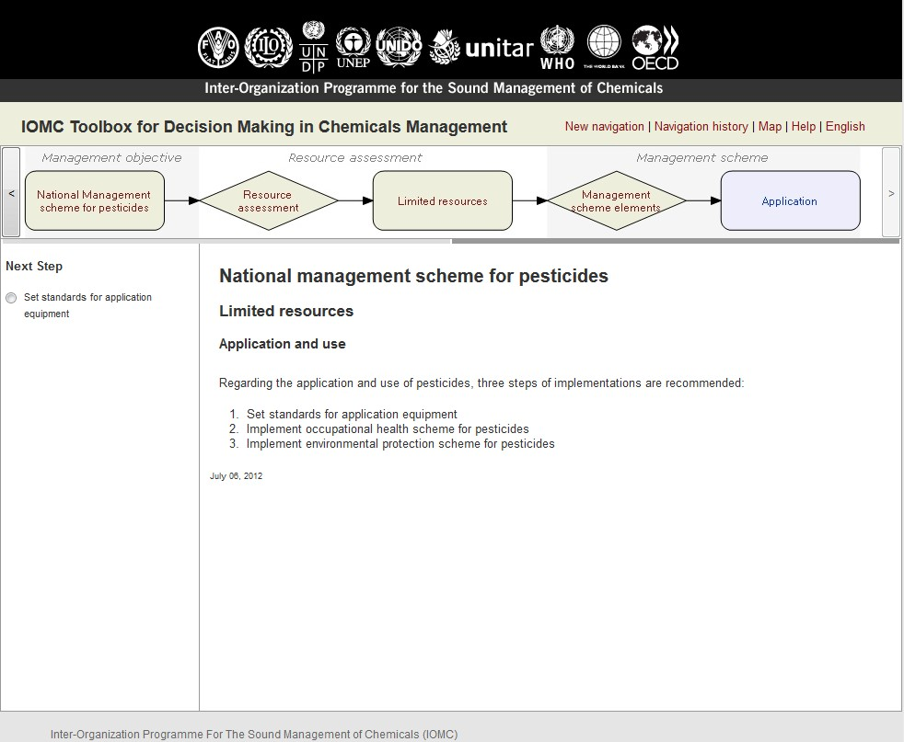
IOMC Toolbox: The Solution
The internet-based IOMC Toolbox
enables countries to identify the most
relevant and efficient national chemicals
management actions
The Toolbox takes into account the
resources available and guides users towards
cost-effective solutions adapted to the country
At each implementation step, the Toolbox presents the relevant IOMC resources, guidance documents, and training material, all available online and free of charge
The project is
implemented
by IOMC
The project is funded by
The European Union

Slide 6
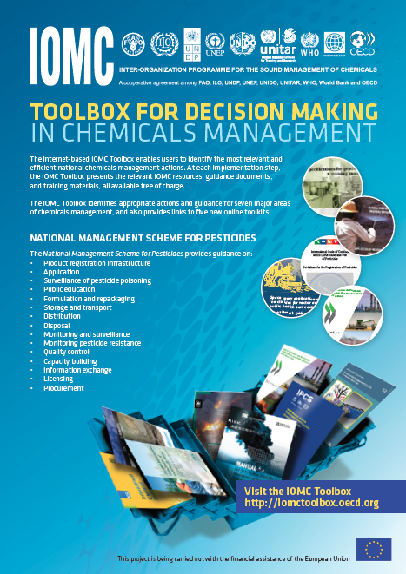
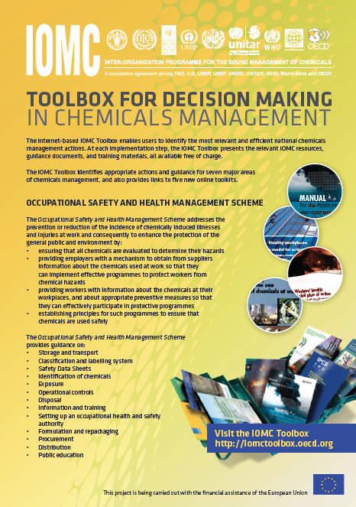
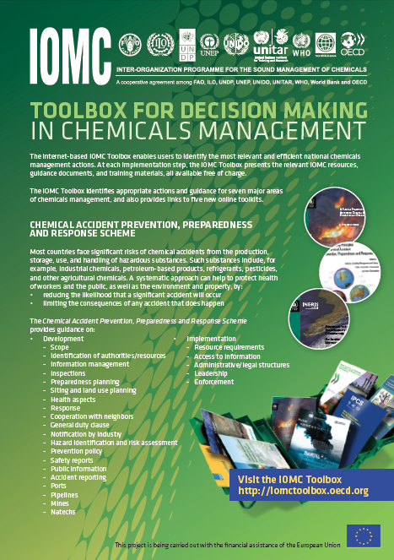
IOMC Toolbox: The Scope
The IOMC Toolbox identifies appropriate actions and guidance for:
  A national management scheme for pesticides
  An occupational health and safety system
  A chemical accidents prevention, preparedness, and response system for major hazards

Slide 7
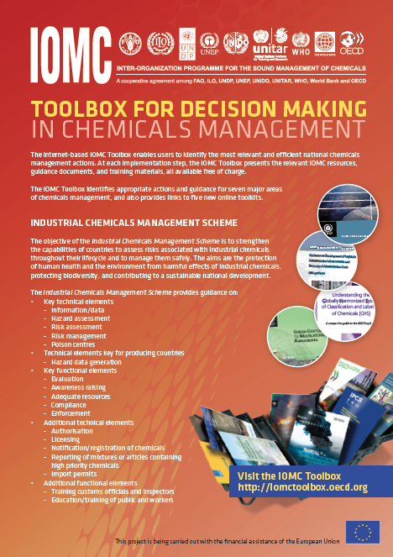
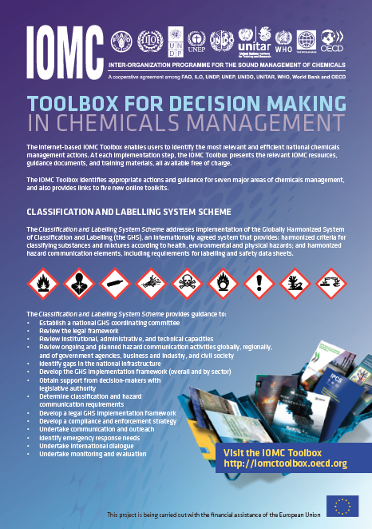
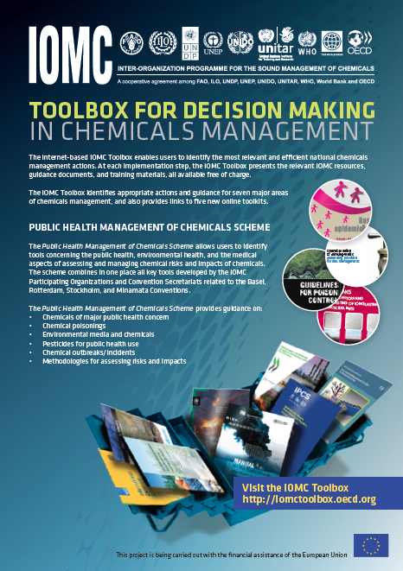
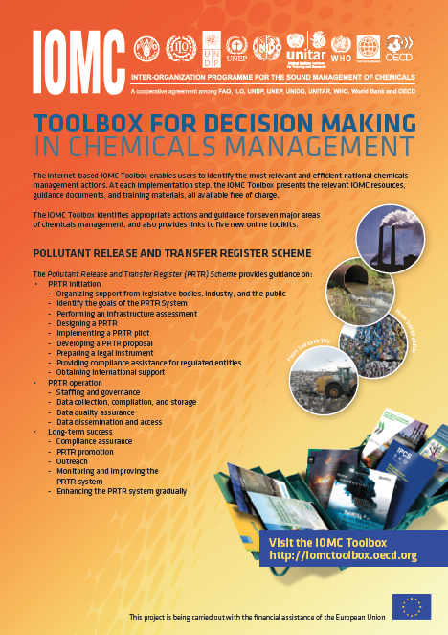
IOMC Toolbox: The Scope
  An industrial chemicals management system (new!)
  A classification and labeling system (new!)
  A system to support health authorities which have a role in the public health management of chemicals (new!)
  Pollutant release and transfer registers (coming soon!)

Slide 8
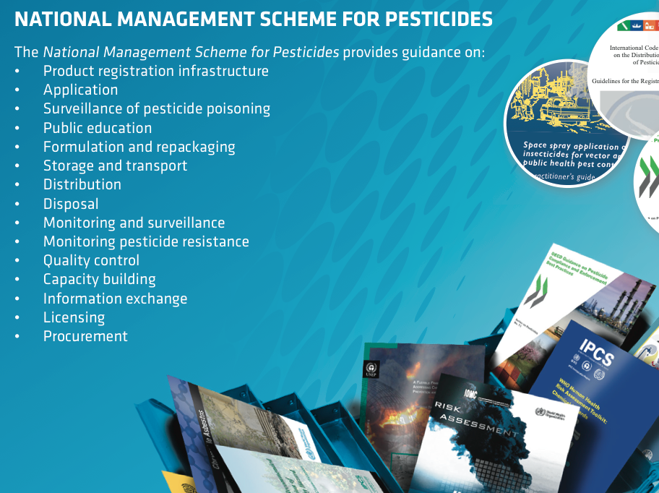
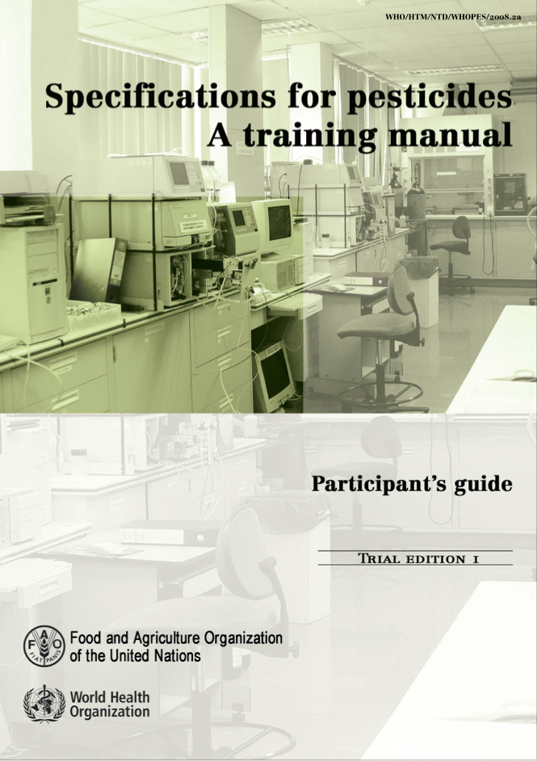
IOMC Toolbox Example:
National Management Scheme for Pesticides
Provides guidance on:
  Product registration infrastructure
  Application
  Surveillance of pesticide poisoning
  Public education
  Formulation and repackaging
  Storage and transport
  Distribution
  Disposal
  Monitoring and surveillance
  Monitoring pesticide resistance
  Quality control
  Capacity building
  Information exchange
  Licensing
  Procurement
The project is
implemented
by IOMC
The project is funded by
The European Union

Slide 9
IOMC Toolbox: The Scope
The IOMC Toolbox also provides links to five new online toolkits:
  OECD Environmental Risk Assessment Toolkit
  WHO Human Health Risk Assessment Toolkit
  FAO Toolkit for Pesticides Registration Decision Making
  UNIDO Toolkit on Innovative, Safe and Resource Efficient Application of Chemicals in Industry
  UNIDO Toolkit on Chemical Leasing
The project is
implemented
by IOMC
The project is funded by
The European Union

Slide 10
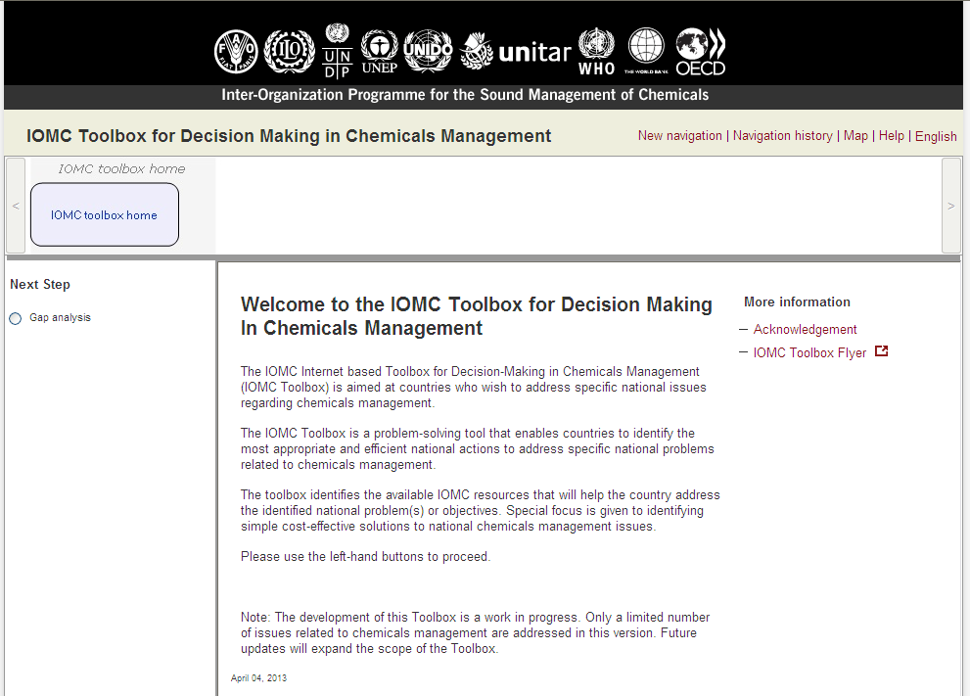

Slide 11
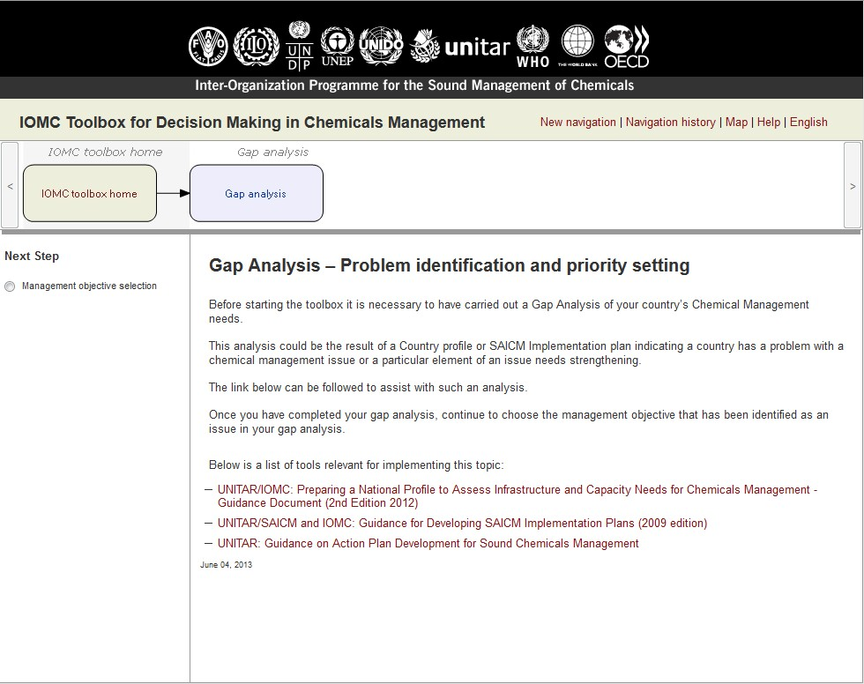

Slide 12
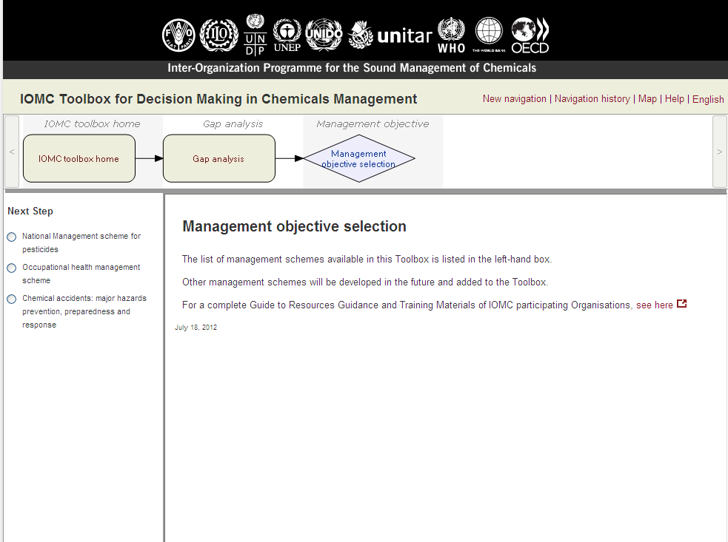

Slide 13
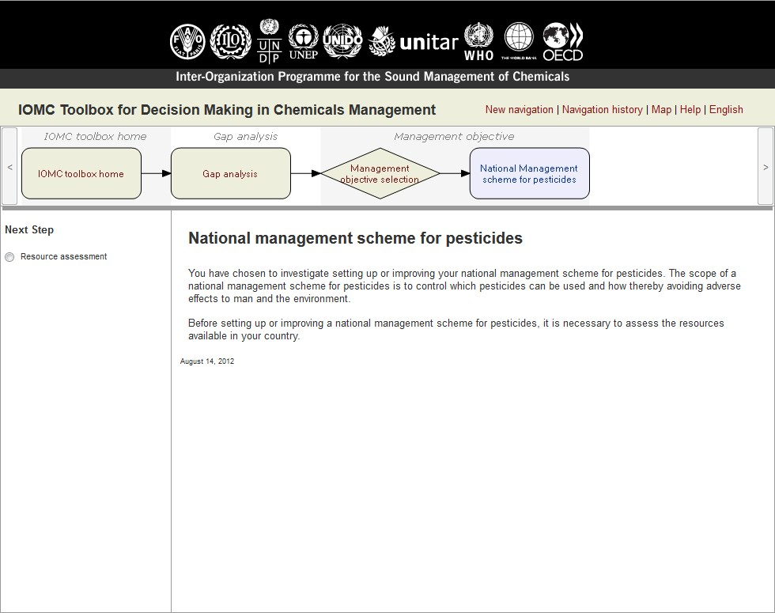

Slide 14
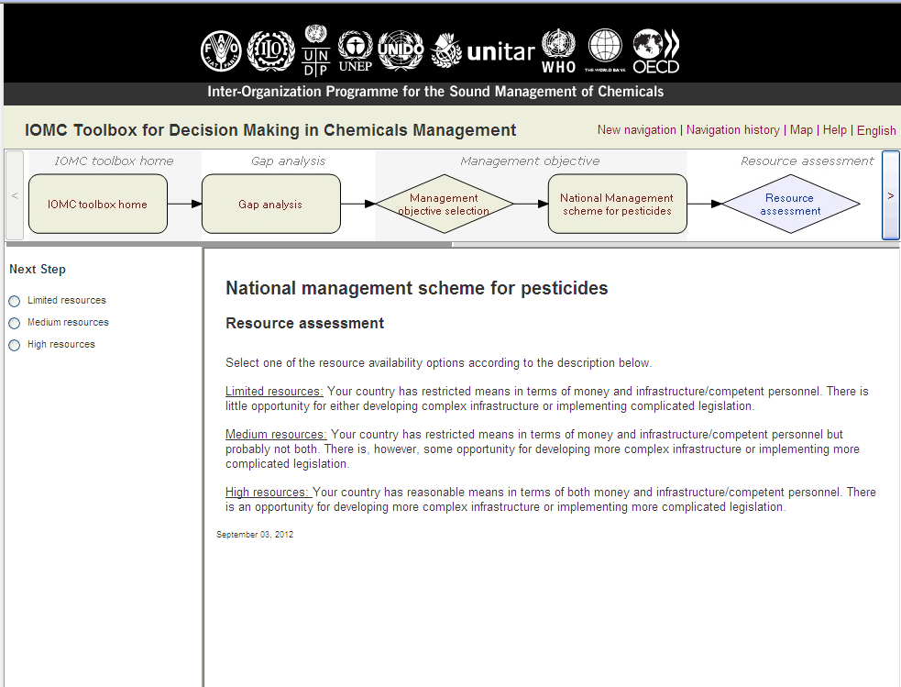

Slide 15
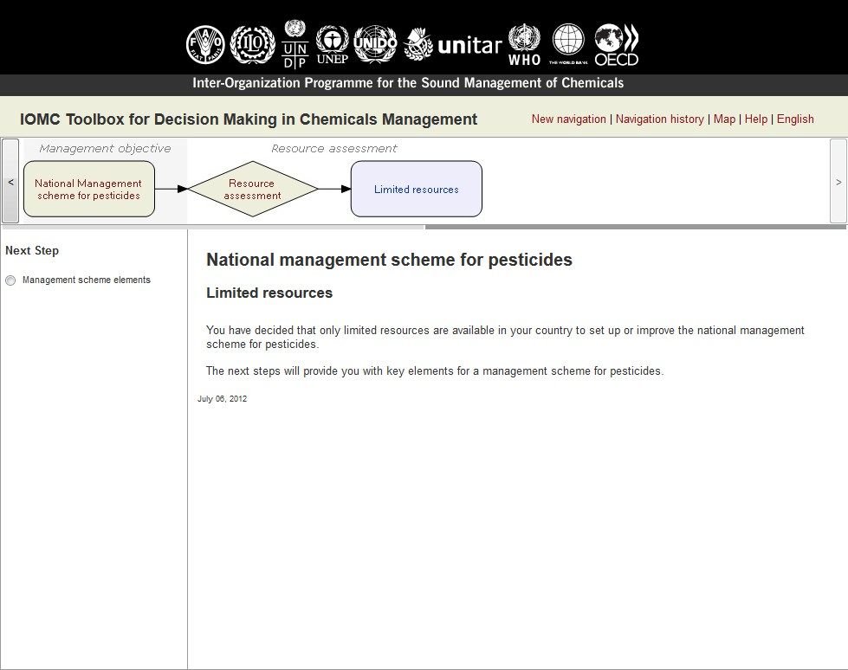

Slide 16
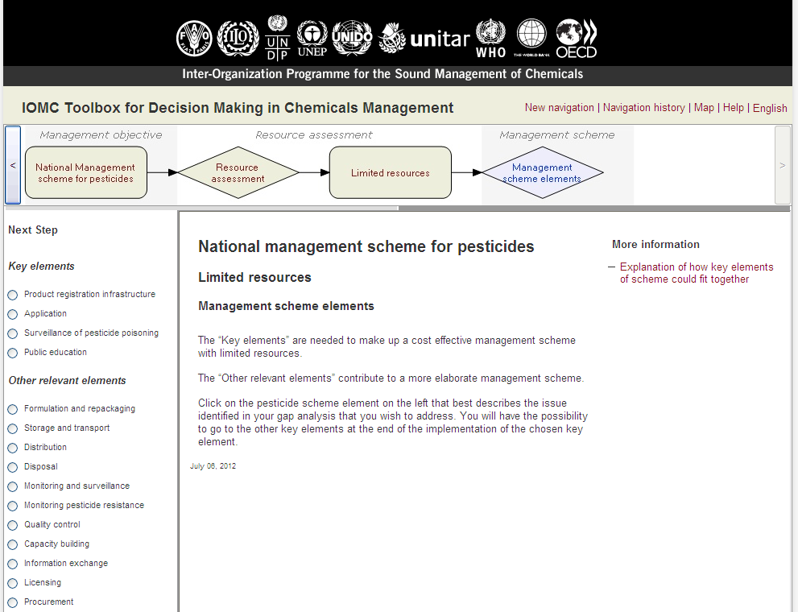

Slide 18
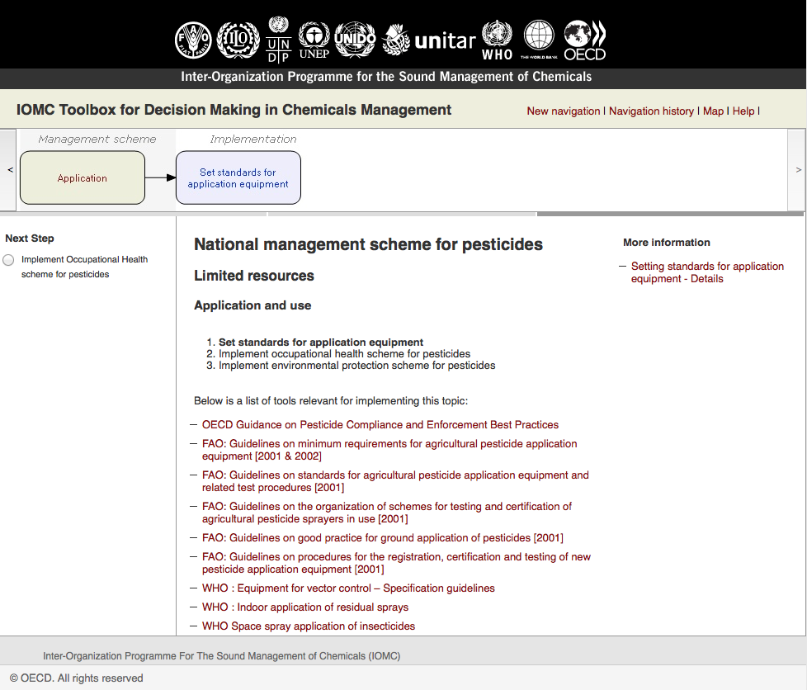

Slide 19
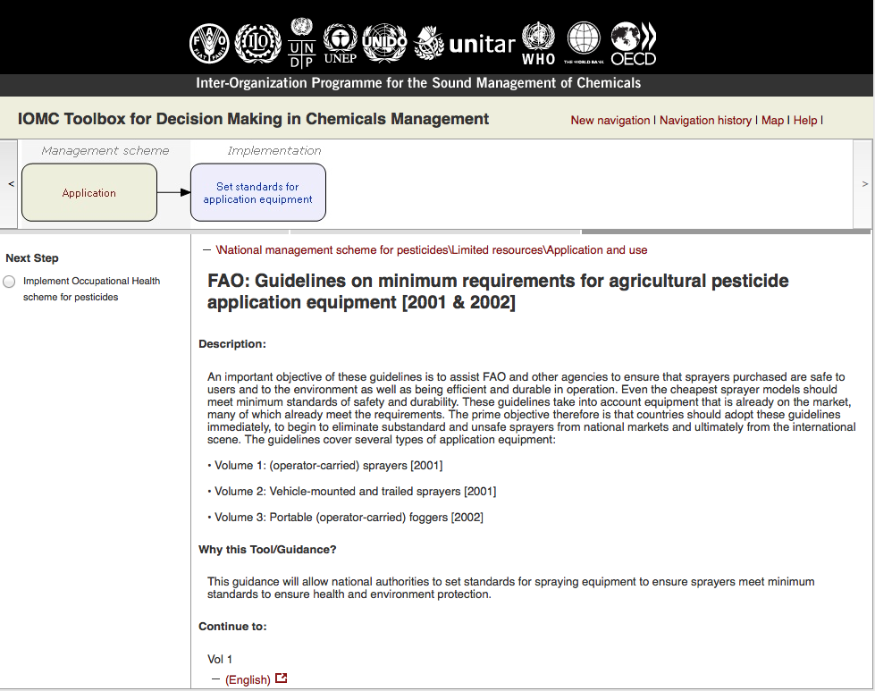

Slide 20
IOMC Toolbox: A Platform for Collaboration
The new version of the IOMC Toolbox provides a set of interactive features allowing governments to use it as a platform for collaboration among ministries, agencies, and other stakeholders such as industry
Users can save their information, add comments, and share and discuss issues with colleagues and partners
The project is
implemented
by IOMC
The project is funded by
The European Union

Slide 21
IOMC Toolbox: Webinars
Introduction to the IOMC Toolbox: Sept 2015
Industrial chemicals management scheme: Oct 2015
GHS scheme: Nov 2015
Pesticides scheme: Dec 2015
The project is
implemented
by IOMC
The project is funded by
The European Union

Slide 22
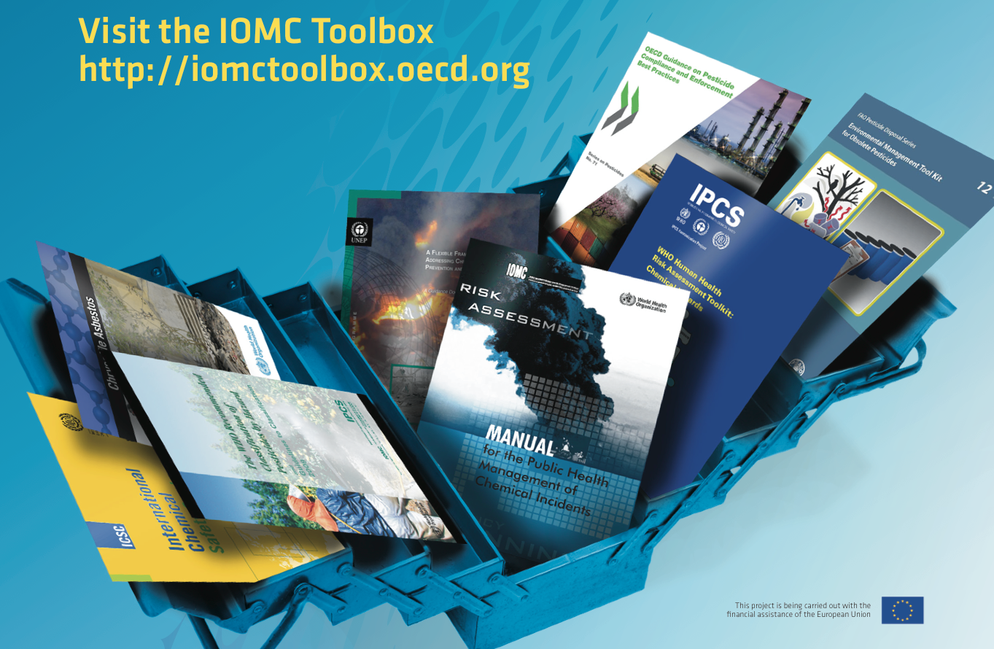
The project is
implemented
by IOMC
The project is funded by
The European Union

