Slide 1
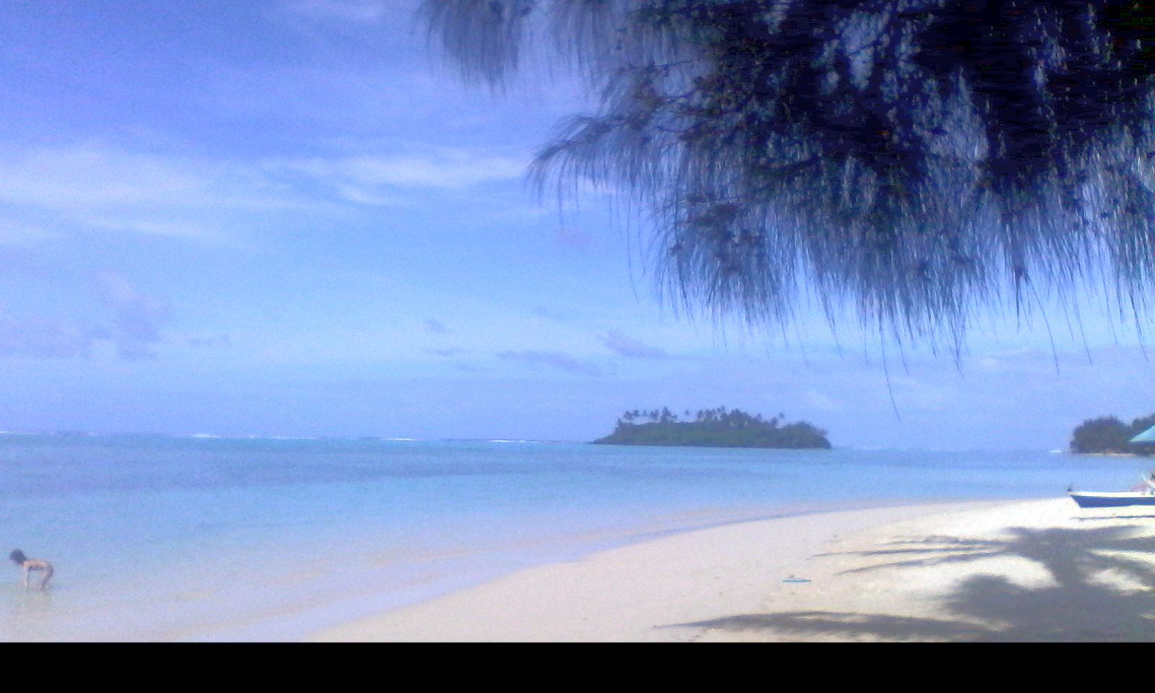

Pacific Perspectives under SAICM on Safety of Manufactured Nanomaterials
Presented by Ms Imogen INGRAM
from Island Sustainability Alliance CIS Inc. („ISACI“)
PO Box 492
Rarotonga
COOK ISLANDS (Pacific Sub-Region)
Email: imogenpuaingram@gmail.com

Slide 2
IPEN Nano Working Group
IPEN (International POPs Elimination Network) is made up of over 800 international NGOs from 5 continents. 50 of these, including several in the Asia-Pacific Region, belong to IPEN‘s nano working group, set up in 2009.
In 2013 the declaration formulated about workeres health was formulated at a multi-stakeholder meeting. It is available here: http://bit.ly/169xHWn).
It called for a precautionary approach by all international organizations (including ILO, FAO, WHO ) and further called for industry to keep workers inform their workers with regard to workplace use of nanomaterials.

Slide 3
IPEN Information Booklet
IPEN has prepared an information booklet entitled „The Social and Environmental Implications of Nanotechnology Development in Asia-Pacific“, covering each of the five sub-regions. It is available for downloading from the sites below:
http://ipen.org/pdfs/nano_booklet_sept_5.pdf http://www.ipen.org/pdfs/Nanotechnology_en.pdf)

Slide 4
IMPORTANCE OF SAICM FORUM
SAICM has provided the only global forum for discussion of nanomaterials and related issues among Small Island Developing States, developing countries and countries with economies in transition.
Notable achievements have been the reports on nanomaterials presented to SAICM OEWG1 and ICCM3 and the inclusion of nano specific activities in the Global Plan of Action.
Thanks to UNITAR for enabling partici-
pation of Civil Society, and to NANOTEC
for our excellent meeting arrangements

Slide 5
Great Expectations for
Use of Nanotechnology – And Reality Check
Initially, nanotechnology offered technical solutions to environmental issues. Suggested applications included remediation of contaminated soils e.g. zero-valent iron); cheap potable water treatment; effective wastewater treatments; energy production and storage; delivery of medical drugs in cancer treatment.
In reality the applications have been mostly
product-oriented e.g. odorless and stain
resistant textiles, cosmetics, better performing
sport equipment etc…
The rationale for governments to use nano
solutions is avoidance of future budgetary costs
caused by poor health and ecosystem damage.

Slide 6
Reasons for Caution With Regard to Manufactured nanomaterials
HazMat suits and hermetically-sealed laboratories required when working with nanomaterials because of the danger of ingesting nanoparticles
Toxicology of manufactured nanoparticles to human health and the environment varies greatly when comparing the bulk form with the manufactured nanomaterial e.g. titanium dioxide
Some carbon nanotubes act like asbestos
Some nanoparticles have shown severe toxicity to fish species and
freshwater ecosystems
Exposure to silver nanoparticles in young males affects
sperm quality
Some nanoparticles crossed the blood-brain barrier,
and others transfer through the placenta to the foetus

Slide 7
WHAT WE DO & DON’T KNOW
ABOUT SAFETY OF NANOMATERIALS
Studies have shown that there are unwanted effects, but not enough is known about how to evaluate them or how to anticipate and counteract them
Environmentally-sound disposal of products containing manufactured nanomaterials has not been adequately addressed
Given this uncertainty, authories owe their citizens
a duty of care and should foster full life-cycle
management of products containing
manufactured nanomaterials

Slide 8
DECLARATION ON NANOMATERIALS
In 2013, IPEN CSOs participated at a seminar held in Latin America about the impact on workers of nano development. It was attended by social scientists, chemists and physicists, trade unionists and a lawyer.
A joint declaration was formulated, which has received wide support. It called for a precautionary approach by all international organizations (including ILO, FAO, WHO ) with regard to the impact of nano on workers; further, it called on industry globally to inform their workers when using nanomaterials.
The declaration is available here: http://bit.ly/169xHWn)
Similar declarations were made in other regions,
including Africa.

Slide 9
RELEVANCE OF THE REGIONAL RESOLUTIONS TO PACIFIC SMALL ISLAND STATES
The main focus of these resolutions was:
  To uphold the principle that if there is no data, then there is no market
  No nano wastes for countries which cannot deal with them appropriately
  Implementation of precautionary regulatory framework
  Enabling countries & consumers to have the Right to know about products containing manufactured nanomaterials. As importer countries, Pacific SIDS could use the Global Harmonized System for Customs Tariffs to
  identify such products [pictograms like the“Nano
  Mark” would be effective, after certification]

Slide 10
PACIFIC SIDS NANO ISSUES Page 1
Yesterday‘s presentation on wastewater indicated that there is insufficient data regarding the impact on human health & the environment. Pacific SIDS do not have the capacity to deal with treatment of discarded products containing nanomaterials in an environmentally sound manner., so more research is needed.
Proper treatment of nanoparticles in wastewater are of special importance to Pacific SIDS. First, tourism is a significant revenue earner for Pacific SIDS, but a lot of wastewater is generated by this sector. Wastewater treatment is focused mainly on bacterial pollution but remediation of chemical pollution
(including nanoparticles) is needed e.g. Agricultural
pesticides; nanosilver from washing textiles

Slide 11
PACIFIC SIDS NANO ISSUES Page 2
There is now evidence that nanoparticles are being detected in
fish, which we rely on for our daily protein. We would like
biomonitoring of fish in order to determine if there is a
threat to food security and also to ensure measures are taken to reduce
exposure from traditional food sources.
Many Pacific SIDS give licences to distant fishing nations for commerical
fishing in their EEZ. The majority of the tuna fish on the Tokyo fish
market comes from the Pacific. So international consumers should
also be assured that the fish on their plate is of good quality.
Marine plastic debris is also a concern to Pacific SIDS because the breaking of waves on barrier reefs can create nanoparticles in the
that contain residual POPs or heavy metals from the
colours in the plastics. Current collection activities
now taking place in the Indian Ocean need to be
expanded to the Pacific Ocean.

Slide 12
PACIFIC SIDS NANO ISSUES Page 3
Canadian research [see Canadian Chemicals News, Nov/Dec 2014] indicates that wastewater ultrafiltration does not pick up all nanoparticles; and then there us the problem of what to do with them after they have been captured. Common practice is to spray dried sewage sludge on agriculture fields, which results in return of the pollutant to the environment. The implication is that nanoparticles in freshwater system will drain into the ocean,where they are circulated and become ingested by the fish that we depend on for daily protein.
Reduction of marine pollution is one of the features of SDG#14, a stand-alone goal for the protection and promotion of oceans that is of high
importance to Pacific SIDS. It will be negotiated as part of the
17 Sustainable Development Goals later this s month in
New York the Summit will be held on Post-2015 Development
Agenda.

Slide 13
GUIDELINES TO CREATE PRECAUTIONARY FRAMEWORK FOR NANOMATERIALS
More is required in terms of political will and financial commitments to implement the collaborative actions in the Global Plan of Action that were recommended at ICCM3.
Discarded products containing nanomaterials need to be treated as hazardous wastes using BAT-BEP, in
parallel with efforts to draft the legal and technical
guidelines to establish a precautionary
framework for safer use.
THANK YOU FOR LISTENING !

