Slide 1
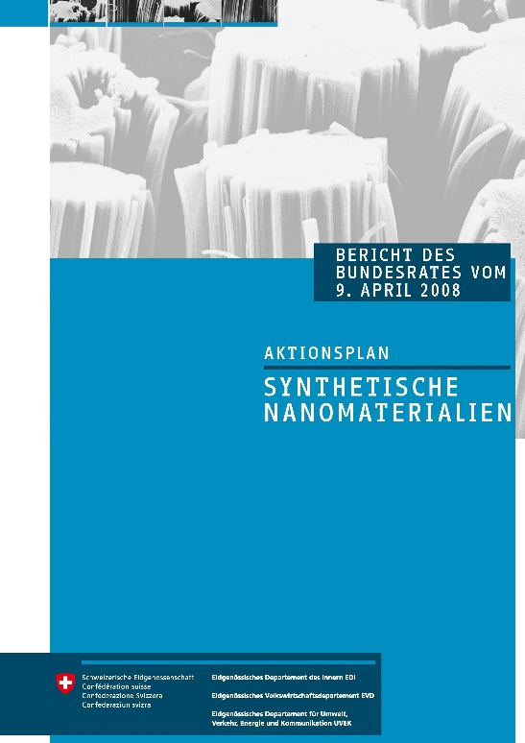
The Swiss Action Plan on Synthetic Nanomaterials: State of implementation
Georg Karlaganis Regional Nano Workshop for Asia Pacific Bangkok Thailand 10 September 2015

Slide 2
Objectives of the Action Plan
Creating the framework for a responsible handling of synthetic nanoparticles
Creating scientific and methodolocial conditions to recognise and prevent possibly harmful effects of synthetic nanomaterials on health and the environment
Promoting public dialogue about the promises and risks of nanotechnology
Better use of existing promotional instruments for the development and market launch of sustainable applications on nanotechnology

Slide 3
Focus on Regulatory Framework
Adapting Swiss Legislation - where necessary (notification and authorisation procedures, limit values, restrictions, etc.)
Interpretation of Applicable Law:
Substantiate the self-control responsibilities
Directive about the requirements on material safety data sheets for synthetic nanomaterials
Directive about the safe disposal of synthetic nanomaterials from industry and business
Better information of consumers prevention about nanomaterials in consumer goods
Analysis of need for action in the of major chemical accidents: criteria and thresholds for fire and explosion hazards with oxidisable (or reducing) nanoparticles, incident scenarios
Precautionary matrix for synthetic nanomaterials
Developing the scientific and methodical knowledge (reaearch programmes, OECD Working Party on Manufactured Nanomaterials, ISO
2008
??

Slide 4
The Precautionary Matrix
is a method for determining “nanospecific risk“ of synthetic nanomaterials and of their applications.
is a voluntary measure that can be taken into account within the framework of individual responsibility.
Research
and
Development
allows a comprehensive view of the nanospecific risks connected to synthetic nanomaterials.
in its latest version 3.0 offers improved evaluation of material reactivity, potentially missing data, as well as recommendations on further clarification.
is available online at www.infonano.ch
Waste disposal
Primary Production
Consumption
Further
Processing
Trade
Finishing

Slide 5
Rating Criteria
Basic parameters (N,S)
Nano yes / no (N)
Independent from other parameters: lack of knowledge (S)
V = need for precaution
⇒ the result is a number! Put it on a scale for comparison / analysis
V = f (X, Y, Z)
V = N . (W . E + S)
Potential effect (W)
material properties/ effect
Potential human
exposition (E)
Potential environmental
exposition (E)

Slide 6
Ranking
Points | Ranking | Significance
0 - 20 | A | The nano specific risk can be ranked as minor, even without the presence of further risk investigations.
> 20 | B | Nano specific risk cannot be ruled out. There is a need for further risk determination or risk reduction measures adressing production, usage and disposal, which are recommended in terms of the precautionary approach.

Slide 7
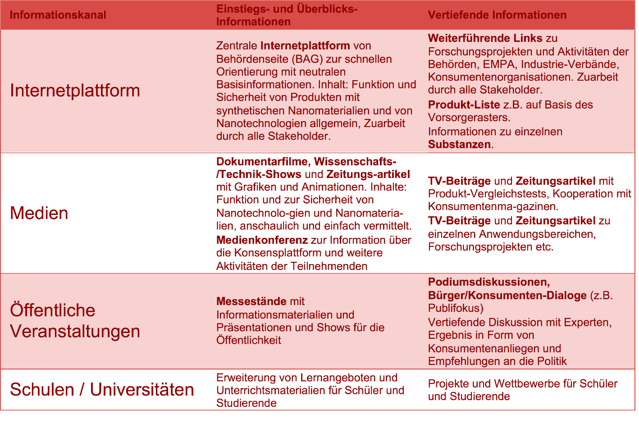
Dialoge Platform – Consumer Information about Synthetic Nanomaterials in consumer goods Participators: consumers‘ interests organisations, industrial associations, retail business, administration
Ideas for general consumer information:
Results:
The recommended coordinated website platform will be reduced to practice within the framework of “communication and promotion of the public dialogue“.

Slide 8
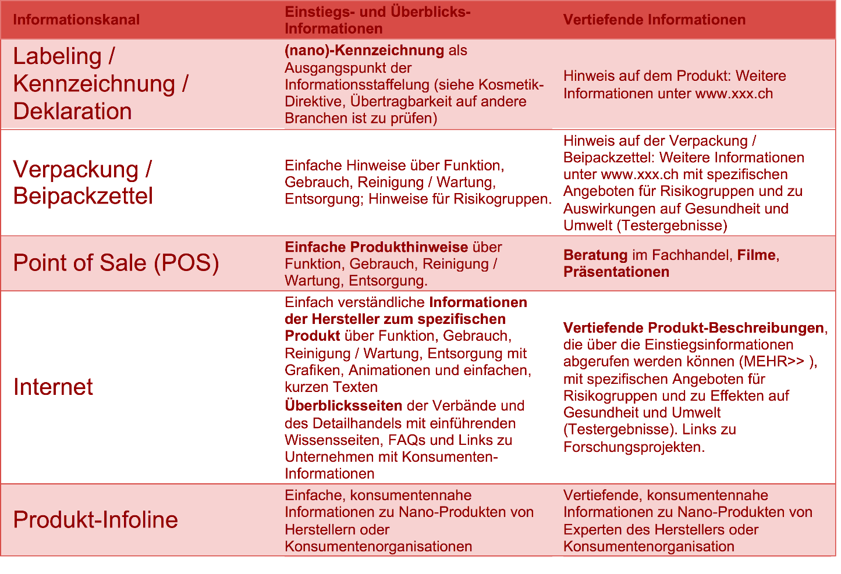
Ideas for product specific consumer information:
Results:
According to the NANO dialogue platform, the labelling question also comprises an in-depth analysis, what kind of label is suitable for different sectors (hazard-based lebelling; information labelling).
Without definitions of manomaterials and a solid basis for hazard and risk assessment, the labellig issue is difficult to tackle.
Swiss labelling efforts must be designed in compliance with the EU, in order to avoid technical trade barriers for Swiss products within the European markets.
No common position and recommendation

Slide 9
Swiss Action Plan: Table of Content 1 Analysis of the situation
2.1 Communication and promoting dialogue
2.2 Effects on humans and the environment
2.3 Health protection at the workplace
2.4 Developing methods for measuring and testing:
standardising terminology
2.5 Risk assessment and regulation
2.6 Benefits of nanotechnology to consumers,
employees and the environment

Slide 10
Swiss Action Plan, Table of Content 2: Measures
3.1 Communication and promotion of public dialogue on the opportunities and risks of nanotechnology
3.2 Creating scientific and methodological conditions to recognise and prevent possible harmful impacts of synthetic nanoparticles on health and the environment
3.3 Creating regulatory framework conditions for the responsible handling of synthetic nanomaterials
3.3.1 Phase 1 (short and medium term): Strengthening the industry’s own responsibility
3.3.2 Phase 2 (medium and long term): Creating statutory framework conditions for the safe handling of synthetic nanomaterials
3.4 Better use of existing promotional instruments

Slide 11
Swiss Action Plan, Table of Content 3: Appendices
4.1 Communication and the promotion of public dialogue about the opportunities and risks of nanotechnology
4.1.1 Technology Assessment (TA)
4.2 Creating the scientific and methodological prerequisites for recognising and preventing possible harmful impacts of synthetic nanoparticles on health and the environment
4.2.1 Research promotion
4.2.2 Standardisation of terminology, definitions, and methods for testing, measuring and evaluation

Slide 12
Swiss Action Plan, Table of Content 4: Appendices
4.2.3 Health protection at work
4.3 Creating a regulatory framework for the responsible handling of synthetic nanomaterials
4.3.1 Synthetic nanomaterials under REACH
4.3.2 “Risk matrix” for products and applications using synthetic nanomaterials
4.3.3 Voluntary measures by the industry: Codes of Conduct and risk management systems

Slide 13
New Swiss legal requirements for nanomaterials (1): Definition of the term nanomaterials
Chemicals Ordinance (ChemO, SR 813.11), Article 2, paragraph 2, letter q Nanomaterial means a material containing particles in an unbound state or as an aggregate or as an agglomerate, where one or more external dimensions is in the size range 1-100 nm, or a material where the specific surface area by volume is greater than 60 m2/cm3. A material is only considered to be a nanomaterial if it is deliberately produced to utilise the properties arising from the defined external dimensions of the particles it contains, or from the defined surface area by volume of the material. Fullerenes, graphene flakes and single wall carbon nanotubes with one or more external dimensions below 1 nm are considered to be nanomaterials.

Slide 14
New Swiss legal requirements for nanomaterials (2) New reporting requirements
Chemicals Ordinance (ChemO, SR 813.11), Article 49
The registration application must contain the following data:
For substances in the case of nanomaterials:
the composition, particle form and mean particle size and, where available, the number size distribution, specific surface area by volume, crystal structure, aggregation status, surface coating and surface functionalisation,

Slide 15
New Swiss legal requirements for nanomaterials (3) New reporting requirements
Chemicals Ordinance (ChemO, SR 813.11), Article 49
The registration application must contain the following data: in the case of preparations containing nanomaterials: the composition of the nanomaterials, the particle form and mean particle size and, where available, the number size distribution, specific surface area by volume, crystal structure, aggregation status, surface coating and surface functionalisation.

Slide 16
New Swiss legal requirements for nanomaterials (4)
Nano-specific data requirements were introduced in the Plant Protection Products Regulation (PSMV, SR 916.161, Appendices 5 and 6)
Nano-specific data requirements were introduced in the Ordinance on Biocidal Products (OBP, SR 813.12; Article 9, paragraph 3; Article 11, paragraph 1, letter d; Article 11h, letter c; Article 38, paragraph 3, letter g).
Since October 2012, Nanomaterials must be declared in authorization applications for pharmaceuticals.

Slide 17
Legal work in progress in Switzerland
The assignment of nanomaterials to existing substances, new substances and preparations according to the Swiss chemicals regulation leads to uncertainties. Therefore, a revision proposal for the ChemO will be worked out in order to place nanomaterials under the notification procedure for new substances (ChemO, SR 813.11, Articles 16 to 19).
Detailed rules for nanomaterials will be prepared for the Swiss food law to comply with EU regulations for food and cosmetics (middle of 2016).
Reporting requirements will be drafted for enterprises which manufacture and process nanomaterials in order to improve workplace safety. Inspection by authorities will be possible.

